Slide 1

Model View Controller (MVC) Design Pattern
By James Moran
Notes:
Hello and welcome to this presentation on the Model View Controller Pattern (MVC). I, James Moran, will be giving this presentation, let’s begin.

Slide 2
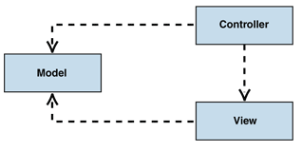
What is the MVC?
MVC Overview
Model
View
Controller
(Microsoft, © 2018a)
MVC Class Structure Diagram
(Microsoft, © 2018b)
Notes:
What is the MVC? It separates modelling of the logical-framework, visual-presentation and handling user-input, into three separate design aspects for a project. The Model handles the business-logic of the application, responding to requests for information from the View, given the current state, as well as any commands to change state (such as the user clicking on a button in the View), from the Controller. The View is the visual aspect for the application, in the case of the Game Café, showing a form with various controls, that show information to the user, garnered from the Model (such as Membership Information) and allow traversal through the application (via form navigation buttons, to access a certain part of the system).

Slide 3
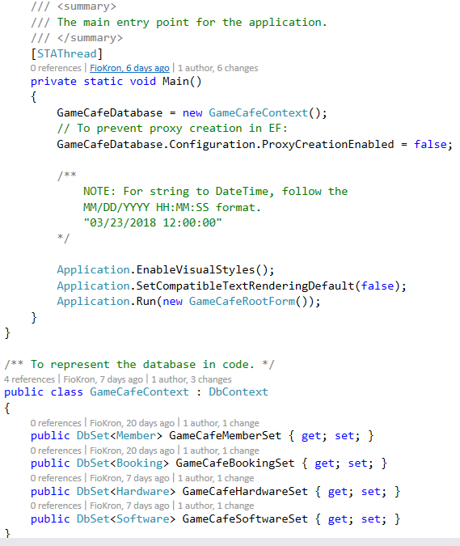
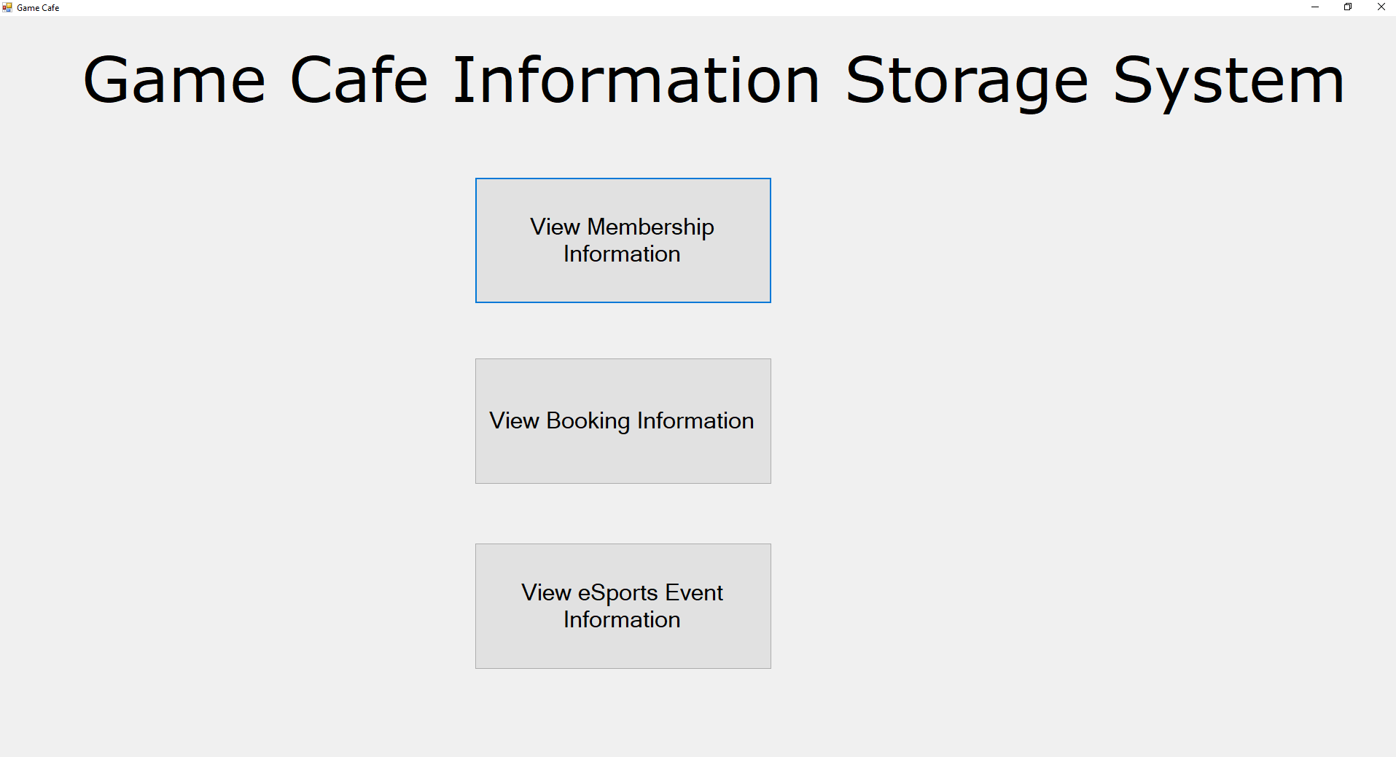
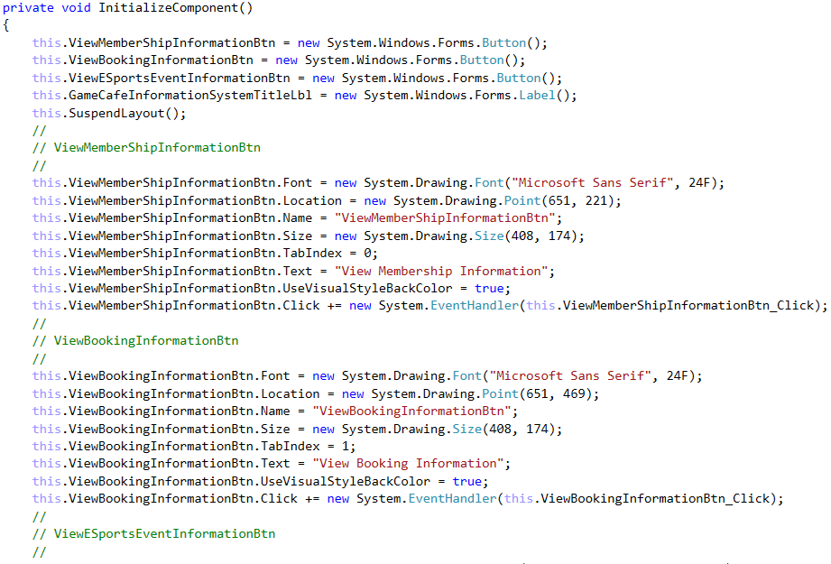
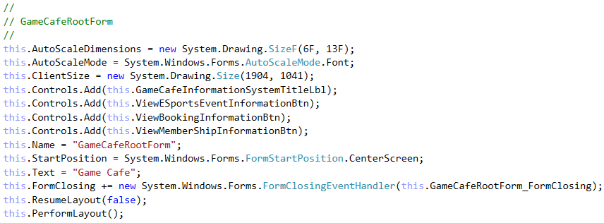
Usage in the Game Café
Model
View
Controller
Notes:
Considering the Game Café as an example, the Model has a representation of the Database and its tables, for the information that is stored about certain aspects of the Game Café (e.g. for Members, Bookings and Hardware available at the Game Café). There is a utility class (IDUpdateSystem), to handle updating the ID for each of these objects, whenever a new entry is added to the database. Next comes the View of the system, allowing the user to interact with the Model and Controller (by either traversing between forms or viewing information). This leads into the Controller, with the logic for the form visual-aspect, along with event-handlers for certain controls on this form, as well as event-handlers for the form itself (such as when the form is closing). The logic for these events, is contained within a class for the form, given what will occur when these events are raised (e.g. asking the User to confirm their choice).

Slide 4
Use of the MVC Design Pattern In the Game Café
Advantages Utilised
Supports Multiple Views
Accommodates Change
Disadvantages Encountered
Complexity
(Microsoft, © 2018c)
Notes:
Considering the use of the MVC Design Pattern within the Game Café system, the advantage of Supporting Multiple Views (allowing the user to change the appearance of the system’s forms, as the view is separated from the Model), will allow for User-preferred customisability and also allow for the ease of Accommodating for Change (most notably, that of changing User-Interface Requirements, e.g. the User wants to view the application on another device). So far, although the potential complexity of the MVC Design Pattern, has caused issues in changing the Model and View together (syncing in with the Controller), these instances of such difficulty (and hence, poorly allocated project hours), have only occurred on a few occasions in the project (most notably, at the early stages of implementation).

Slide 5
References
MICROSOFT, © 2018a. Model-View-Controller [Viewed on the 27/03/2018]. Available from: https://msdn.microsoft.com/en-us/library/ff649643.aspx
MICROSOFT, © 2018b. MVC class structure [Digital Image] [Viewed on the 27/03/2018]. Available from: https://msdn.microsoft.com/en-us/library/ff649643.aspx (Figure 1: IC114765.gif)
MICROSOFT, © 2018c. Model-View-Controller (Resulting Context Header)[Viewed on the 27/03/2018]. Available from: https://msdn.microsoft.com/en-us/library/ff649643.aspx
Notes:
This slide details the references used in this presentation, thank-you for taking the time to watch this presentation and goodbye for now.

